Slide 1
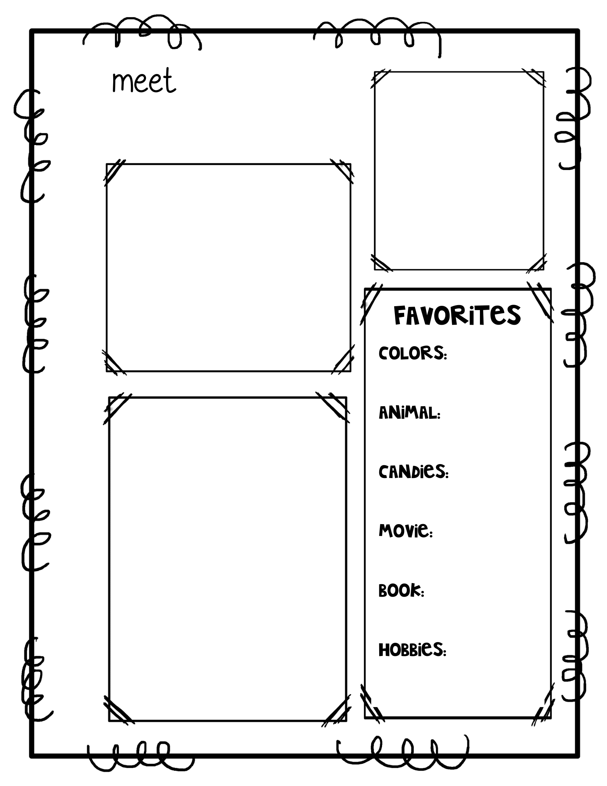
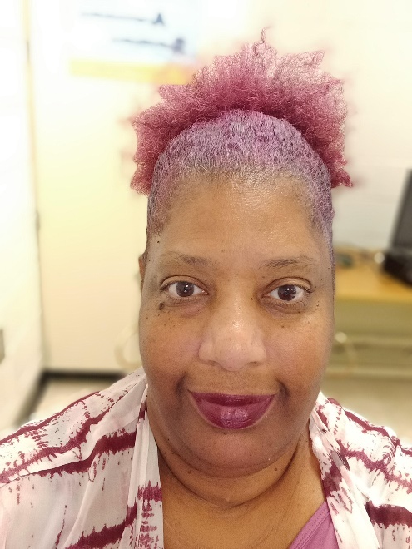
Ms. S. Davis
T
E
C
H
N
O
L
O
G
Y
Every day may not be good, but there is something good in every day!
BLUE
My name is Shannon Davis. This will be my 32nd year working in the Richmond County School System.
I received my Bachelor's Degree in Early Childhood Education from Augusta State College. I received my Master's Degree in Technology in Education from Lesley University.
I have one daughter. Her name is Alana Davis. She is a 2021 graduate of the University of Memphis.
CATS
BABY RUTH
Friday
Charlotte’s Web
Shopping

